Slide 1
ADT

Slide 2
Abstract Data Type-Definition
A mathematical concept that defines the data type.
This mathematical construct may be implemented using a particular hardware or software data structure.
Data Structures using C: Tenanbaum

Slide 3
Abstract Data Type-Definition
A mathematical model, together with various operations defined on the model
An ADT is a collection of data and associated operations for manipulating that data
Courtesy: https://www.geeksforgeeks.org/abstract-data-types/

Slide 4
Abstract Data Type-Definition
Defined as a "class of objects whose logical behavior is defined by a set of values and a set of operations“
The definition of ADT only mentions
  what operations are to be performed
  but not how these operations will be implemented.
Courtesy: https://www.geeksforgeeks.org/abstract-data-types/

Slide 5
Abstract Data Type
It does not specify
  how data will be organized in memory and
  what algorithms will be used for implementing the operations.
  Not concerned with space and time complexity
  Not concerned with implementation details at all
Courtesy: https://www.geeksforgeeks.org/abstract-data-types/

Slide 6
Abstract Data Type
May not even be possible to implement a particular ADT on a particular piece of hardware or using a particular software system
Courtesy: https://www.geeksforgeeks.org/abstract-data-types/

Slide 7
Abstract Data Type
Data abstraction
Providing only essential information about the data to the outside world, hiding the background details or implementation.

Slide 8
Abstract Data Type
Consider a real-life example of a man driving a car.
The man only knows that pressing the accelerator will increase the speed of the car or applying brakes will stop the car
but he does not know how on pressing the accelerator the speed is actually increasing,
he does not know about the inner mechanism of the car or
the implementation of the accelerator, brakes, etc in the car.

Slide 9
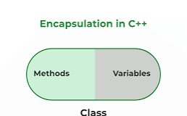
Abstract Data Type
Encapsulation-
Encapsulation refers to the bundling of data with the methods that operate on the data.
In Object Oriented Programming, Encapsulation is defined as binding together the data and the functions that manipulate them.

Slide 10
Abstract Data Type
Encapsulation-
Most OOP languages implement encapsulation primarily through classes and the objects instantiated through those classes.
A class defines a set of attributes for the data and the methods used to carry out operations related to the data.

Slide 11
Abstract Data Type
Encapsulation-
Think of ADT as a black box which hides the inner structure and design of the data type.
The principle of hiding the used data structure and to only provide a well-defined interface is known as encapsulation.

Slide 12
Abstract Data Type
ADTs support abstraction, encapsulation, and information hiding.

Slide 13
ADT Operations
Every Collection ADT should provide a way to:
Create data structure
add an item
remove an item
find, retrieve, or access an item
  No single data structure works well for all purposes, and so it is important to know the strengths and limitations of several of them

Slide 14
ADT Syntax : Value Definition
abstract typedef < ParameterType Parameter1, ParameterType Parameter2……, ParameterType ParameterN > ADTType
condition:

Slide 15
ADT Syntax : Operator definition
abstract ReturnType OperationName (ParameterType Parameter1, ParameterType Parameter2……, ParameterType ParameterN)
Precondition:
Postcondition:
OR
abstract ReturnType OperationName (Parameter1, Parameter2……, ParameterN)
ParameterType Parameter1, ParameterType Parameter2……, ParameterType ParameterN
Precondition:
Postcondition:

Slide 16

Example ADT : String
Definition: String is a sequence of characters
Operations:
  StringLength
  StringCompare
  StringConcat
  StringCopy

Slide 17
Example ADT : String
Value Definition
abstract Typedef <<Char s>>StringType
Condition: None (A string may contain n characters where n>=0)
abstract Typedef < ParameterType Parameter1, ParameterType Parameter2……, ParameterType ParameterN > ADTType
condition:

Slide 18
Example ADT : String Operator Definition
  1. abstract Integer StringLength (StringType String)
Precondition: None (A string may contain n characters where n=>0)
Postcondition: Stringlength= NumberOfCharacters(String)
abstract ReturnType OperationName (ParameterType Parameter1, ParameterType Parameter2……, ParameterType ParameterN)
Precondition:
Postcondition:

Slide 19
Example ADT : String Operator Definition
2. abstract StringType StringConcat( StringType String1, StringType String2)
Precondition: None
Postcondition: StringConcat= String1+String2 / All the characters in Strings1 immediately followed by all the characters in String2 are returned as result.
abstract ReturnType OperationName (ParameterType Parameter1, ParameterType Parameter2……, ParameterType ParameterN)
Precondition:
Postcondition:

Slide 20
Example ADT : String Operator Definition
  3. abstract Boolean StringCompare( StringType String1, StringType String2)
Precondition: None
Postcondition: StringCompare= True if strings are equal, StringCompare= False if they are unequal . (Function returns 1 if strings are same, otherwise zero)

Slide 21
Example ADT : String Operator Definition
4. abstract StringType StringCopy( StringType String1, StringType String2)
Precondition: None
Postcondition: StringCopy: String1= String2 / All the characters in Strings2 are copied/overwritten into String1.

Slide 22
Example ADT : Rational Number
Definition: expressed as the quotient or fraction of two integers,
Operations:
  makeRational()
  IsEqualRational()
  MultiplyRationa()
  AddRational()

Slide 23
Example ADT : Rational Number
Value Definition
abstract TypeDef<integer x, integer y> RATIONALType;
Condition: RATIONALType [1]!=0;
abstract typedef < ParameterType Parameter1, ParameterType Parameter2……, ParameterType ParameterN > ADTType
condition:

Slide 24
ADT Syntax : Operator definition
abstract ReturnType OperationName (ParameterType Parameter1, ParameterType Parameter2……, ParameterType ParameterN)
Precondition:
Postcondition:
OR
abstract ReturnType OperationName (Parameter1, Parameter2……, ParameterN)
ParameterType Parameter1, ParameterType Parameter2……, ParameterType ParameterN
Precondition:
Postcondition:

Slide 25
Example ADT : Rational Number Operator Definition`
abstract RATIONALType makerational<x,y>
integer x,y;
Preconditon: y!=0
postcondition :
makerational [0] =x
makerational [1] =y
abstract RATIONALtype add<a,b>
RATIONALType a,b;
Precondition: none
postcondition :
add[0] = a[0]*b[1]+b[0]*a[1]
add[1] = a[1] * b[1]

Slide 26
Example ADT : Rational Number Operator Definition
abstract RATIONALType mult<a, b>
RATIONALType a,b;
Precondition: none
Postcondition :
mult[0] = a[0]*b[0]
mult[1] = a[1]*b[1]
abstract ReturnType? Equal<a,b>
RATIONALType a,b;
Precondition: none
Postcondition: equal=true if a[0] * b[1] = = b[0] * a[1]

Slide 27
ADT Syntax : Operator definition
Abstract ReturnType OperationName (ParameterType Parameter1, ParameterType Parameter2……, ParameterType ParameterN)
Precondition:
Postcondition:
OR
Abstract ReturnType OperationName (Parameter1, Parameter2……, ParameterN)
ParameterType Parameter1, ParameterType Parameter2……, ParameterType ParameterN
Precondition:
Postcondition:

Slide 28
Example ADT : Complex Number
Definition: expressed as summation of the real and imaginary part
Operations:
  makeComplex()
  IsEqualComplex()
  add()
  sub()
  mul()

Slide 29
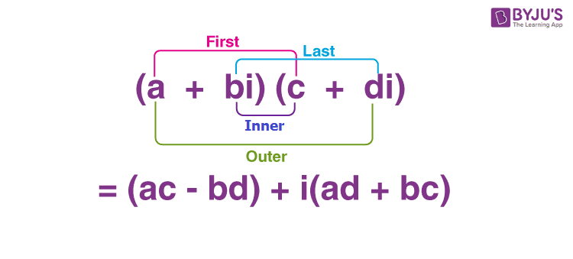
Example ADT : Complex Number

Slide 30
Example ADT : Complex Number
Value Definition
abstract TypeDef<integer x, integer y> COMPLEXType;
Condition: COMPLEXType [1]!=0;
abstract typedef < ParameterType Parameter1, ParameterType Parameter2……, ParameterType ParameterN > ADTType
condition:

Slide 31
Example ADT : Complex Number Operator Definition`
abstract COMPLEXType makecomplex<x,y>
integer x,y;
Preconditon: y!=0
postcondition :
makecomplex [0] =x
makecomplex [1] =y
abstract COMPLEXType add<a,b>
COMPLEXType a,b;
Precondition: none
postcondition :
add[0] = a[0]+b[0]
add[1] = a[1]+b[1]

Slide 32
Example ADT : Complex Number Operator Definition`
abstract COMPLEXType sub<a,b>
COMPLEXType a,b;
Precondition: none
postcondition :
sub[0] = a[0]-b[0]
sub[1] = a[1]-b[1]
abstract COMPLEXType mult<a,b>
COMPLEXType a,b;
Precondition: none
postcondition :
mult[0] = a[0]b[0]-a[1]b[1]
mult[1] = a[0]b[1]+a[1]b[0]

Slide 33
Abstract Data Types: Advantages
Hide the unnecessary details by building walls around the data and operations
  so that changes in either will not affect other program components that use them
Functionalities are less likely to change
Localize rather than globalize changes
Help manage software complexity
Easier software maintenance
Courtsey: https://www.comp.nus.edu.sg/~stevenha/cs1020e/lectures/L5%20-%20ADT.pdf

Slide 34
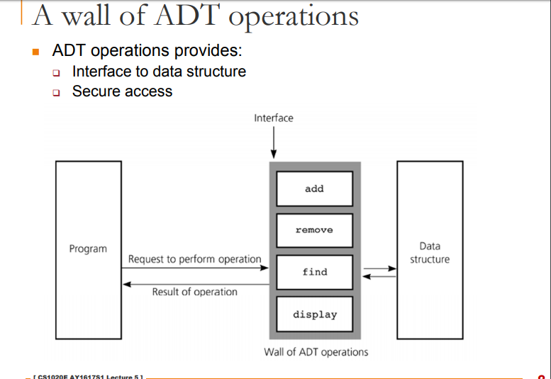
Courtsey: https://www.comp.nus.edu.sg/~stevenha/cs1020e/lectures/L5%20-%20ADT.pdf

Slide 35
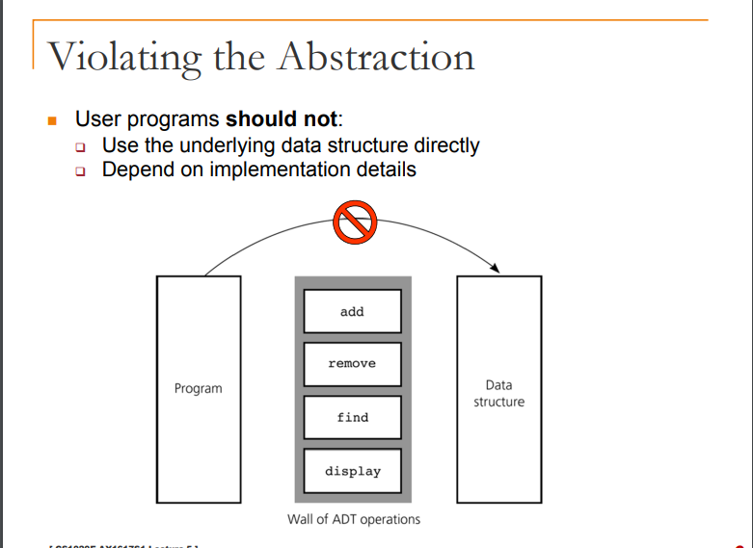
Courtsey: https://www.comp.nus.edu.sg/~stevenha/cs1020e/lectures/L5%20-%20ADT.pdf

Slide 36
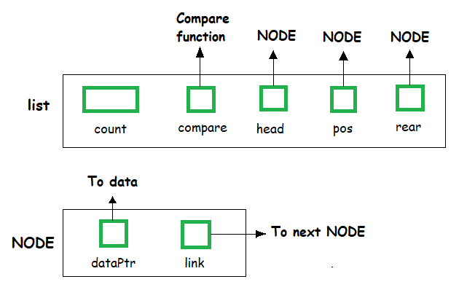
List ADT
The data is generally stored in key sequence in a list which has a head structure consisting of count, pointers and address of compare function needed to compare the data in the list.

Slide 37
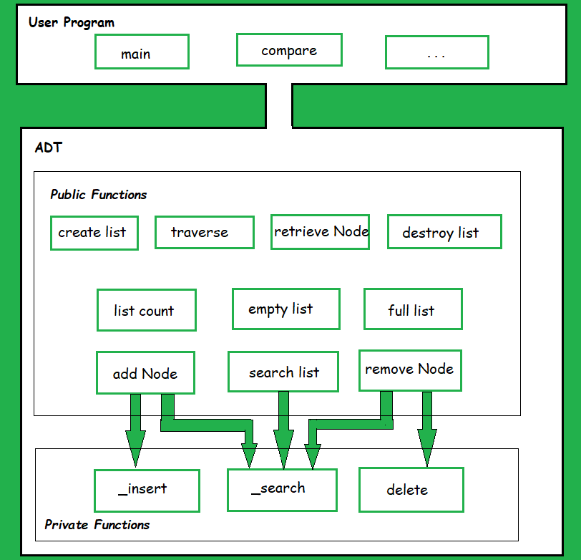
List ADT
List ADT Functions

Slide 38
List ADT
List ADT Functions
get() – Return an element from the list at any given position.
insert() – Insert an element at any position of the list.
remove() – Remove the first occurrence of any element from a non-empty list.
removeAt() – Remove the element at a specified location from a non-empty list.
replace() – Replace an element at any position by another element.
size() – Return the number of elements in the list.
isEmpty() – Return true if the list is empty, otherwise return false.
isFull() – Return true if the list is full, otherwise return false.

Slide 39
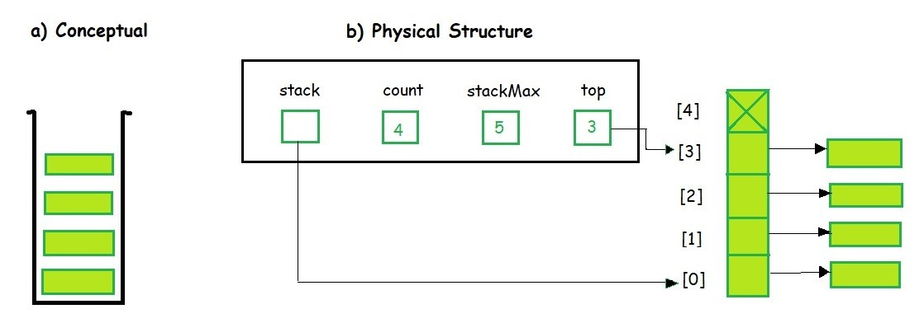
Stack ADT
Instead of data being stored in each node, the pointer to data is stored.
The program allocates memory for the data and address is passed to the stack ADT.

Slide 40
Stack ADT
The head node and the data nodes are encapsulated in the ADT. The calling function can only see the pointer to the stack.
The stack head structure also contains a pointer to top and count of number of entries currently in stack.

Slide 41
Stack ADT
A Stack contains elements of the same type arranged in sequential order.
All operations take place at a single end that is top of the stack and following operations can be performed:
push() – Insert an element at one end of the stack called top.
pop() – Remove and return the element at the top of the stack, if it is not empty.
peek() – Return the element at the top of the stack without removing it, if the stack is not empty.
size() – Return the number of elements in the stack.
isEmpty() – Return true if the stack is empty, otherwise return false.
isFull() – Return true if the stack is full, otherwise return false.

Slide 42
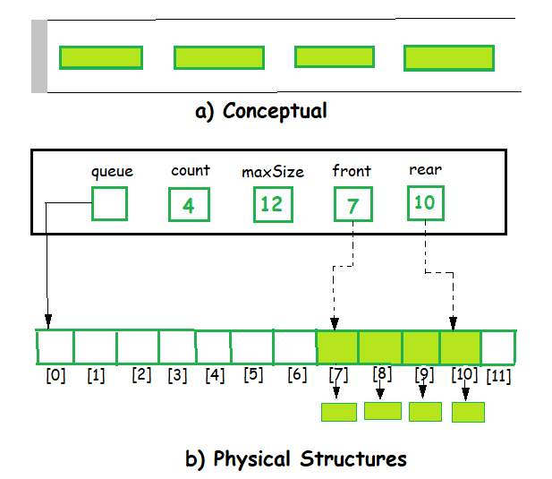
Queue ADT
The queue abstract data type (ADT) follows the basic design of the stack abstract data type.
Each node contains a void pointer to the data and the link pointer to the next element in the queue. The program’s responsibility is to allocate memory for storing the data.

Slide 43
Queue ADT
A Queue contains elements of the same type arranged in sequential order.
Operations take place at both ends, insertion is done at the end and deletion is done at the front.

Slide 44
Queue ADT
Following operations can be performed:
enqueue() – Insert an element at the end of the queue.
dequeue() – Remove and return the first element of the queue, if the queue is not empty.
peek() – Return the element of the queue without removing it, if the queue is not empty.
size() – Return the number of elements in the queue.
isEmpty() – Return true if the queue is empty, otherwise return false.
isFull() – Return true if the queue is full, otherwise return false.

